Slide 1

Dynamically Made RNN - Varying Input Length

Slide 2
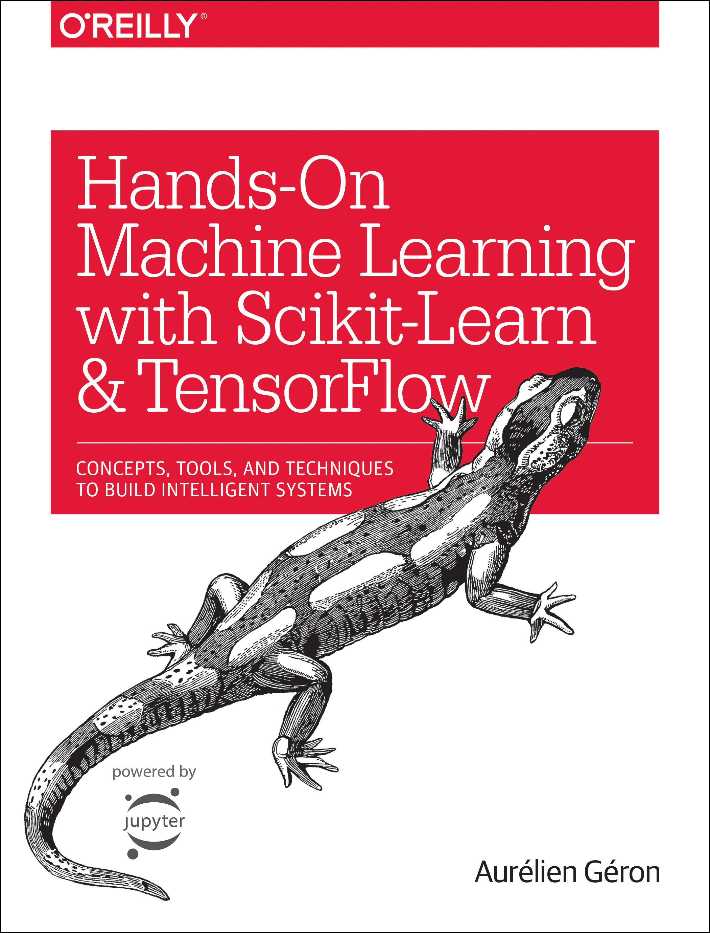
Reference
Chapter 14 (O'Reilly) of Hands-On ML
Youtube
Code

Slide 3
Data

Slide 4
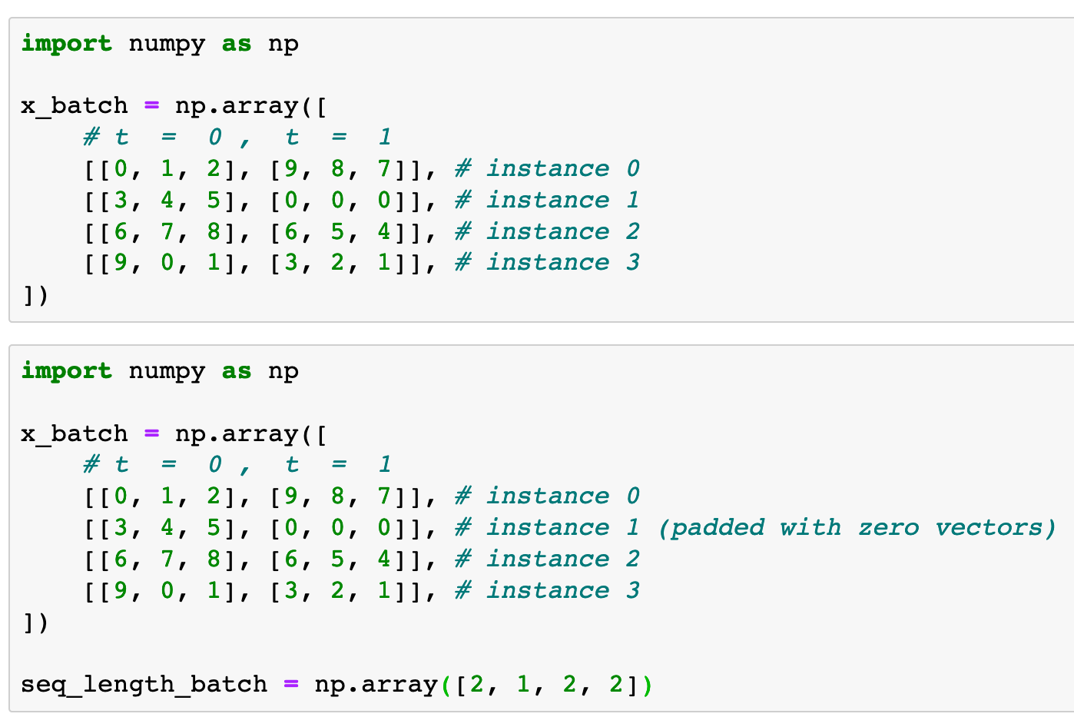

Previously
Now

Slide 5
Previously
Now

Slide 6
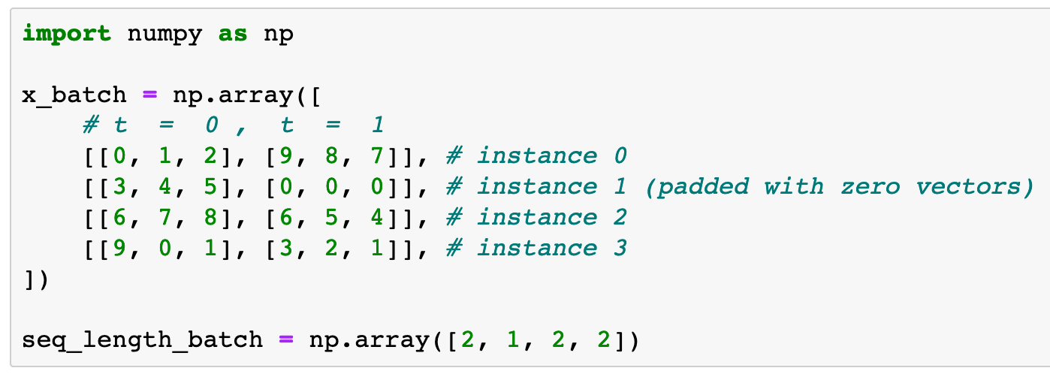

Slide 15
Graph

Slide 16
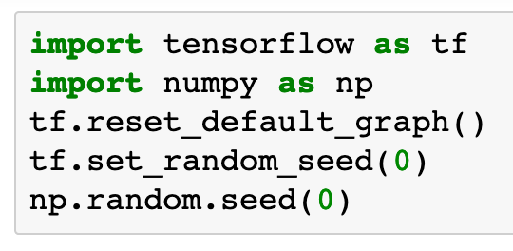

Slide 17
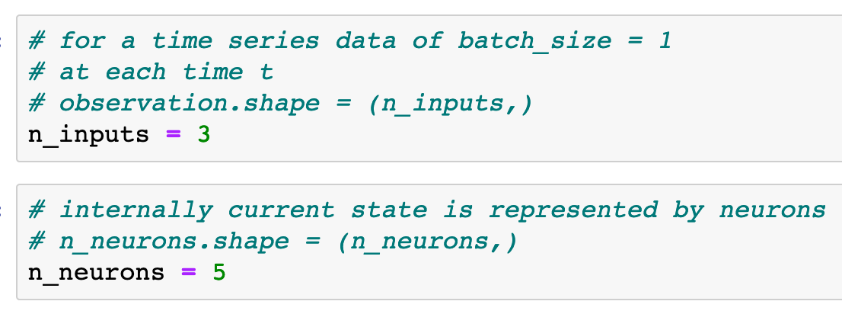

Slide 19
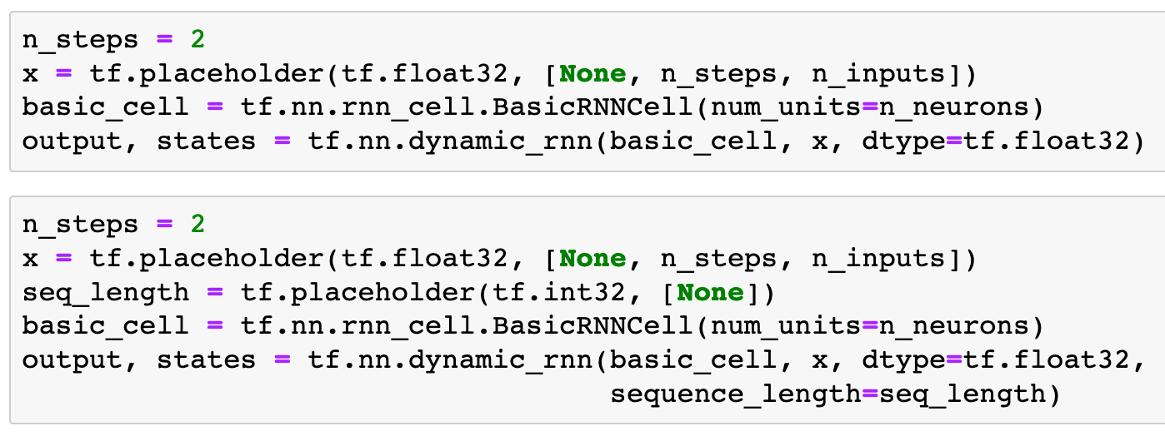
Previously
Now

Slide 20
Previously
Now

Slide 21
Previously
Now

Slide 22
Previously
Now

Slide 23
Previously
Now
These lines are added

Slide 24
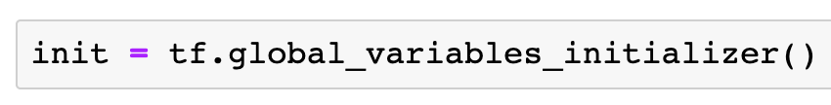

Slide 25
Session

Slide 26
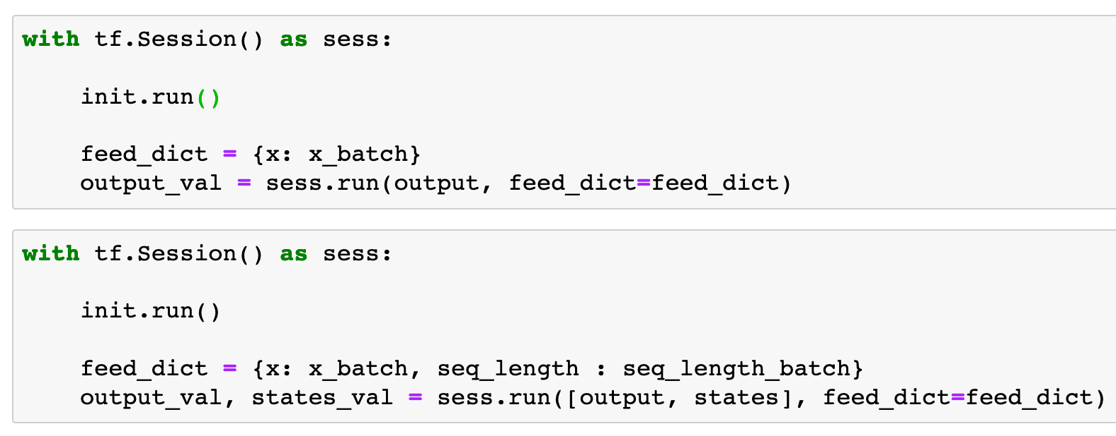

Previously
Now

Slide 27
Previously
Now

Slide 28
Previously
Now

Slide 29
Previously
Now
This is added

Slide 30
Previously
Now

Slide 31
Previously
Now

Slide 32
Previously
Now
These are added

Slide 33
Report

Slide 34
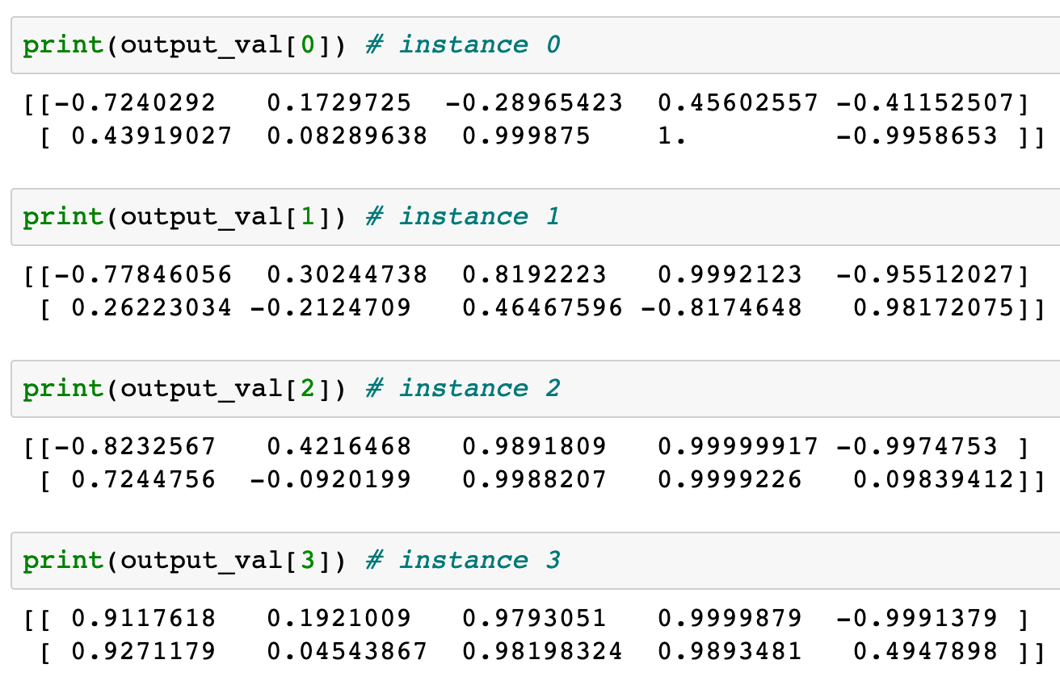
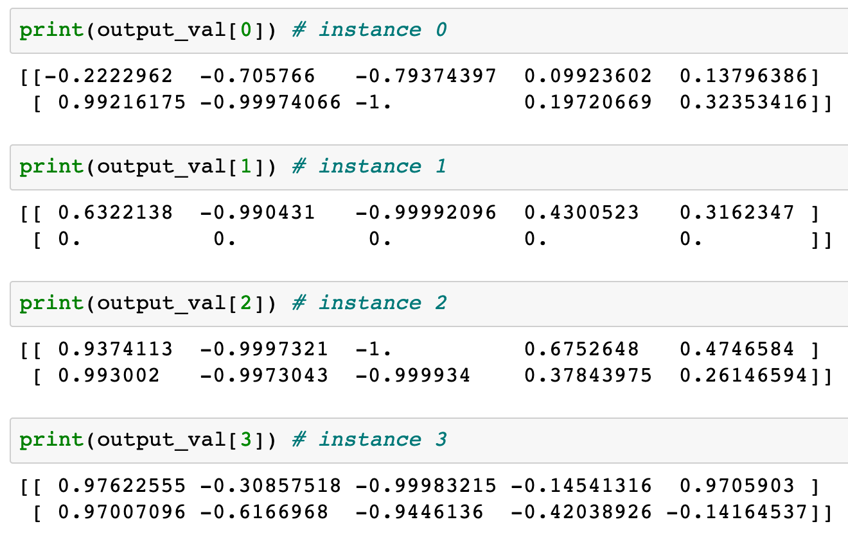
Previously
Now

Slide 35
Previously
Now

Slide 36
Previously
Now

Slide 37
Previously
[0,0,0] was input data
and computed
Now

Slide 38
Previously
[0,0,0] was input data
and computed
Now

Slide 39
Previously
[0,0,0] was input data
and computed
Now
[0,0,0] was padding
and left alone

Slide 40
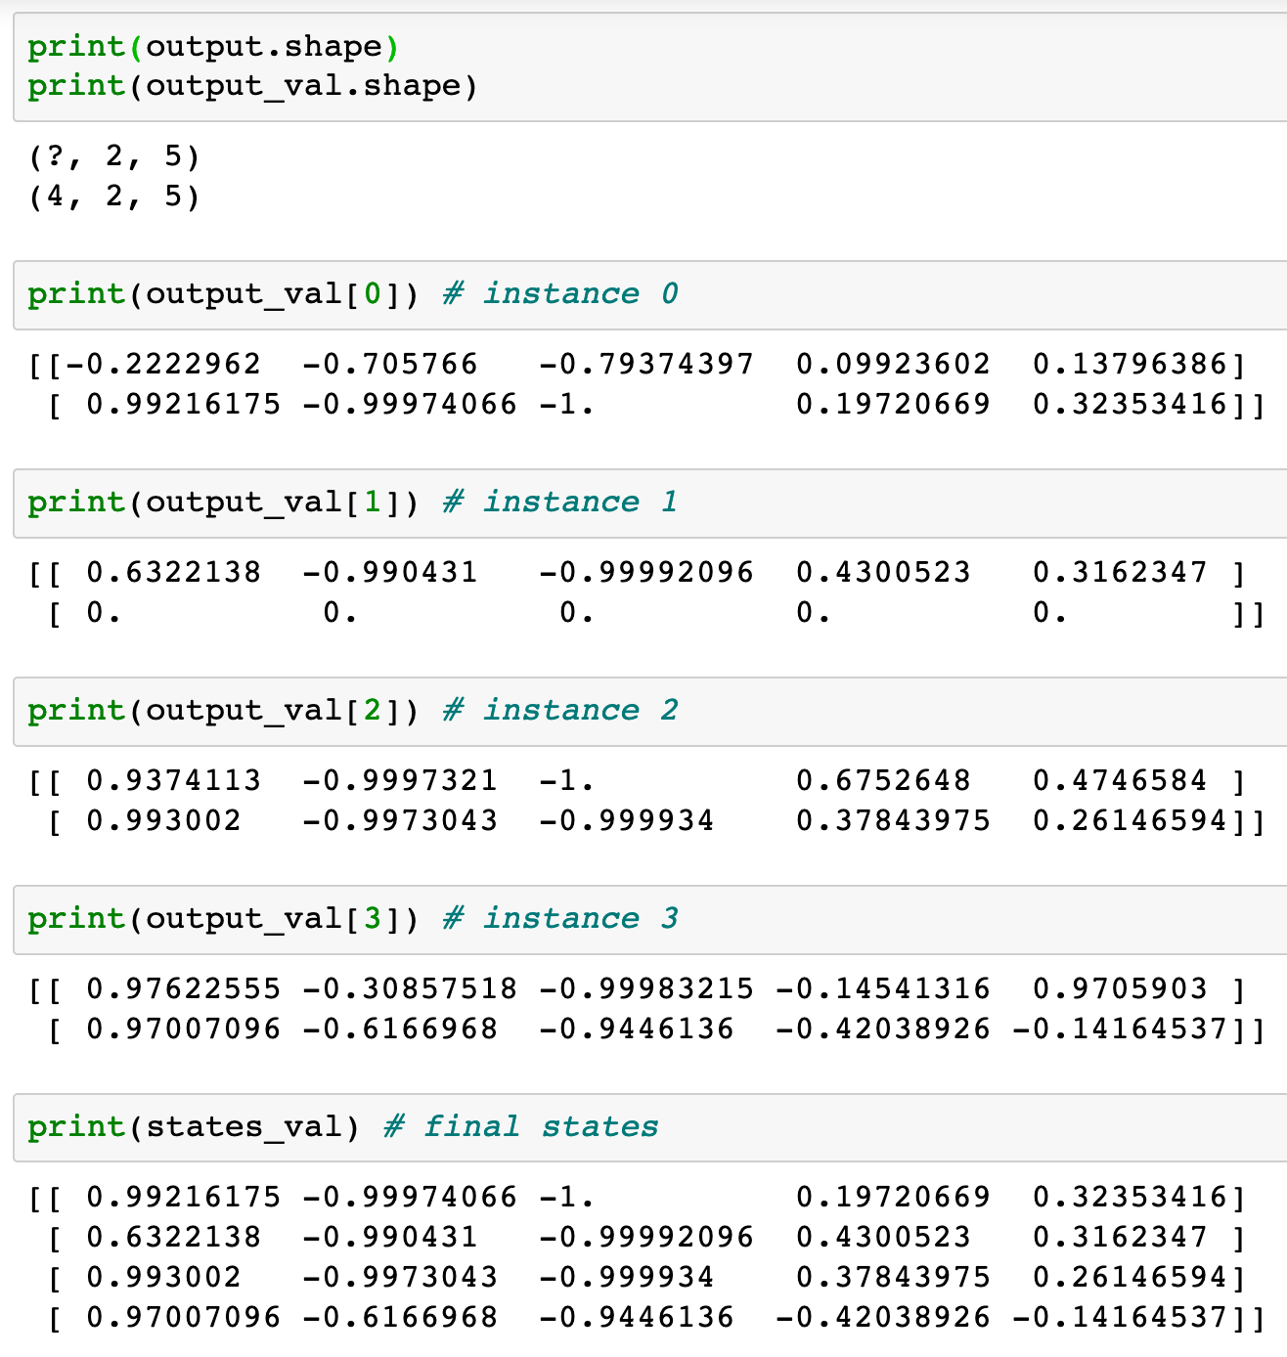

Slide 42
[0,0,0] was padding and left alone

Slide 44
This is final output of instance 1

Slide 45
This is final output of instance 1

Slide 46
This is final output of instance 1
This is final output of instance 1

Slide 47
Now
Let’s Play with Code

